Slide 1
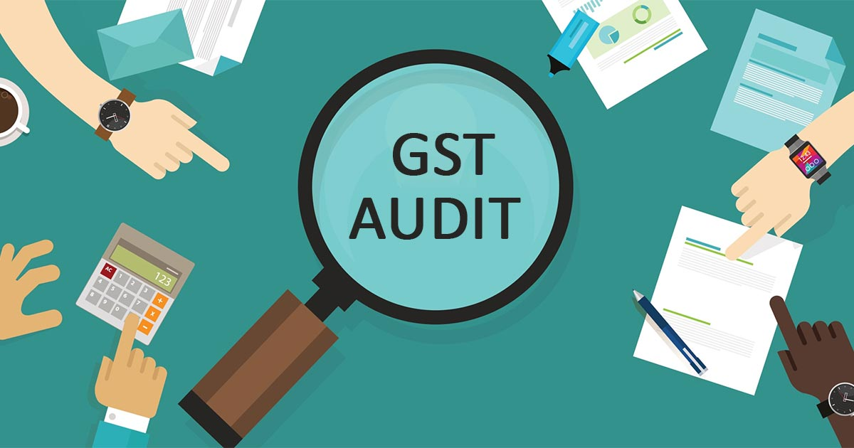
GST AUDIT
VS
GST Reviews
GST AUDIT VS
GST REVIEW
CA Bhavesh Mittal

Slide 2
Coverage
1
2
Proposed Change in budget on GST audit
3
Reasoning for this proposed change
5
4
Abolition of GST audit Boon or Bane ?
7
6
Possible additions in GSTR9
Harsh measures proposed in GST law recently
8
Possible remedy
GST Periodic review
Budget Highlight
Conclusion
10
9
How GST review works

Slide 3
Budget Highlight
Clause 101 of Finance bill, 2021 - GST Audit ( Sec 35(5)) shall be omitted.
Clause 102 of Finance bill,2021 – Substitution of New section for section 44
Council Decision (43rd Meeting – 28th May 2021)-
To notify the amendment under the sections 35 & Section 44
GSTR 9/9A to be optional for taxpayers having aggregate turnover up to 2cr.
Form GSTR 9C is to be filed by taxpayers having aggregate turnover above 5cr.
Changes to be applicable from Return period of FY 2020-21. (Not yet Notified)

Slide 4
Proposed change in budget on GST Audit
Section 35(5) which requires registered person to be audited is being omitted.
Section 44 proposed to be amended to mandate registered to furnish annual return which may include self certified reconciliation statement, reconciling value of Supplies with audited annual financial statement for every FY

Slide 5
Reasoning for this proposed changes
Negative feedback on annual return and audit report of FY 2017-18
Extension of due date for FY 2017-18 several times
Increased cost of compliance as filing audit report requires professional assistance
Collection of Additional tax and interest thereon from GSTR9 was much more than the audit form GSTR9C
Increase in cost as professionals forcing taxpayers to subscribe for additional services

Slide 7
Boon for taxpayers
How it could be boon for taxpayers ?
Saving of audit fee every year
Reduction in number of reconciliations for audit report purpose
Saving on manpower and incidentals to support the auditors
Option to discharge tax liability which otherwise auditor would compel (disputable situations)

Slide 8
Bane for taxpayers
How it could be bane for taxpayers ?
Regular changes in law by way of notifications, orders etc – Failure to assess and implement change which could lead to dispute
Regular clarifications by way of circulars, press release, few advance rulings add to confusion. Non requirement of audit could result in non-confirmation of views taken by auditor
Pandemic has added pressure to all State governments to increase collection. If professional auditor is not there, then it would add more pressure on business as difference in figures between returns such as GSTR-1, GSTR-2A, GSTR-3B and financial statements lead to enquiries
Without audit, unidentified liabilities and excess ITC could lead to demand under Sec 73 or Sec 74

Slide 9
Continued…
Savings on account of audit fee may not be there as it could result in litigation. This may lead to requirement to obtain internal pre-audit GST review to be performed
Confirmation on compliance would always be lacking for investors/ other interested stakeholders
Missing out on value additions/ tax planning possible from auditor such as suggestions on exemptions, concessions, ITC, valuation, export benefits, better documentations etc
With proposed change, onus is on the tax payer to self-certify the supplies declared in the return which was on the auditor earlier. Errors/ wrong disclosure could lead to higher demands under Section 74 with allegation of fraud/suppression of facts/ information.

Slide 10
Possible Additions in GSTR9
Reconciliation of T/O with audited financial statements
ITC Reconciliation with Books
HSN Summary which was optional earlier, may applied compulsorily
Job work and refund details may be applied in GSTR9
Expense level details which was optional in GSTR9C in Table14 may be applied compulsorily in GSTR9

Slide 11
Harsh measures proposed in GST Law recently
Higher declaration of liability in GSTR-1 and lesser in GSTR-3B could lead to recovery proceedings without SCN and opportunity to be heard.
Cancellation of registration when ITC is wrongly claimed
Suspension of registration when GSTR-1 liability is more than liability in GSTR-3B
Blocking facility of utilisation of ITC balance if officers find that ITC taken without valid tax invoice or taxes not paid by vendors

Slide 12
Continued...
Providing a legal backbone to Rule 36(4), which requires a taxpayer to ensure all his vendors are filing their GSTR 1 returns and paying their taxes
Interest on net liability is only on delayed filing of returns, therefore department may demand interest on gross basis when tax liability of a tax period is disclosed in a subsequent tax period
Increase in penalty when goods are confiscated during transit
Right to sell goods and conveyance on failure to pay penalty provided

Slide 13
Possible Remedy
Hire knowledgeable employees, train them regularly to ensure compliance.
Increase the scope of internal auditors who can cover GST compliance to ensure adequacy of compliance
GST audit can be converted into periodic review including assistance in annual return filing with self certification .
Identify specialists till internal team is ready to handle compliance confidently to manage compliance including review of compliance on periodical basis

Slide 15
What is GST Review?
GST Review is nothing but a verification of books of accounts with return.
Provides assurance to management that all necessary precautions as well as compliance done under GST
It will scan source data and identify potential risk and opportunities for business.
It is not just about compliance.

Slide 16
Why tax payers needs a GST review?
GST is growing as a key source of tax revenue for government. The increased focus by revenue department on GST compliance has heightened the importance of businesses to properly manage their GST risk and cash flows. Pursuant to GST law, tax payers have unlearned the past indirect tax concepts. The GST concept is just four years old in India and it has faced lot Challenges in the initial phase. Professionals could help the business entities to understand the intricacies of GST by undertaking periodical review.

Slide 17
Continued…
GST review would make sure that disadvantages listed in heading “ How it could be bane for tax payers” could be negated/mitigated
Review can reduce time involved in filing annual return and provide appropriate level of assurance
Review can reduce confusion and complexity of Form GSTR9, when those requirement listed in heading “Possible additions in GSTR9” will be added to Form GSTR9

Slide 18
Continued…
Completion of GST review gives confidence to management that GST return lodged is correct
It raises awareness within organisation of GST issues
Process of undertaking the review educates personnel about GST compliances issues and the steps can take to mitigate tax risks
GST review can be an opportunity to identify cash flow benefits as well as identifying improvements to efficiency of current system

Slide 19
Benefits of such Review
1
01
Non- Compliance could be identified faster
2
02
Availment of eligible input credits without missing major credits
3
03
Avoid or mitigate possible litigations from department
4
04
Avoid demand in form of interest and penalties for non-compliance
5
Better tax planning and scope to reduce cost of procurements
05
6
06
Exploration of export related benefits
The list is only illustrative, and it can go on.

Slide 21
GST review involves few stage approach
Review consists of few stage approach that is designed by experts to assist management in managing GST risks and maximizing GST opportunities. Proper checklist ( What to check and How to check ) is designed by experts.

Slide 22
Designed Stage
Area specific reviews such as sales, ITC, RCM
Understanding business, Internal control, Automation/ERP
Review of documentation, agreements/contracts, tax credits
Custom review- Import, export, check on FTP benefit
Review Classification and Valuation
Financial statement review

Slide 23
Checklist which can add value to client during GST review- List is only illustrative and it can go on
Check industry specific issues in GST for the clients business. Reference can be made to Compendium of issues book, Case laws/ Advance rulings in the same industry, Research of various articles/ write up's on GSTL, Taxsutra, TMI etc.
Check if any specific notification, circular, press release, flyer, FAQ etc. is issued by the CBIC in respect of the client's industry
check investments by group companies , associated enterprise, RTP, -Notes to accounts, pending litigations, contingent liabilities, foreign currency inflows outflows
In case of multiple business premises, review the benefits of having separate regn. Vis a Vis single regn. Analyse the better option between ISD and cross charge and accordingly suggest
Understand if any taxes were paid due to departmental assessment, audit, verification, search etc. Verify the legaility of the demands raised and the correctness of the calculations viz., tax rate, value adopted etc.
Check whether the activities undertaken is eligible for any exemption. if it can be suggested to pay tax in case of conditional exemptions and avail full ITC instead of exemption - if the same is more beneficial

Slide 24
Continued…
Check that the HSN/ SAC code with the respective nature of Goods/ services - Classification for goods must be as per CTA and in case of services, it must be as per scheme of classification read with explanatory notes.
Scrutinize the ledgers to check if any ITC has been missed. check if the credit is short availed on the supplier's invoice. Back calculate the % of credit availed at invoice level to check if the credit is fully availed at correct rate of tax
check if LUT is executed in case export made without payment of tax. In case client is having accumulated ITC, evaluate the option of making exports with payment of tax
Check if various export benefits under the FTP have been availed i.e. MEIS, SEIS, EPCG, Advance Authorization, Duty Drawback. Analyze if any tax costs can be avoided and claimed as refunds on amounts paid as Penalties, Compensation cess etc.
Verify the refund workings and check whether the computation of the refund claim is correct as per the formula given in rule 89
Check Electronic Cash Ledger if any incorrect deposit of tax is made in interest, late fee, penalty or Compensation cess tab and whether the same can be claimed as refund

Slide 25
Conclusion
Recent fraud cases in GST could be forcing the government to take harsh measures. Steps like abolition of GST audit could be named as a measure to facilitate concept of ‘Ease of doing business’ by the government. However, the bigger picture is being missed by government as this measure could lead to increased non-compliances. However, all is not lost for the tax payers as the services of professionals could still continue even in absence of certification.

Slide 26
Questions?
Thank you for your Generous listening
For any clarification
bhaveshmittal@hiregange.com

